Slide 1
CSE 3100: Systems Programming
Lecture 2: Expressions and Basic Data Types in C
Department of Computer Science and Engineering
University of Connecticut

Slide 2
Lecture Overview
1. Static and Dynamic Typing
2. Expressions and Operators
3. Memory for Data Types and Characters

Slide 3
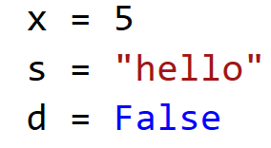
Recall: What did an expression look like in Python?

Slide 4
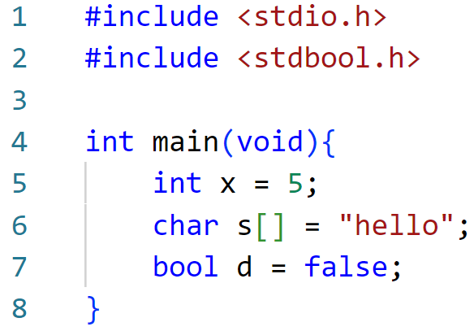
What does an expression look like in C?

Slide 5
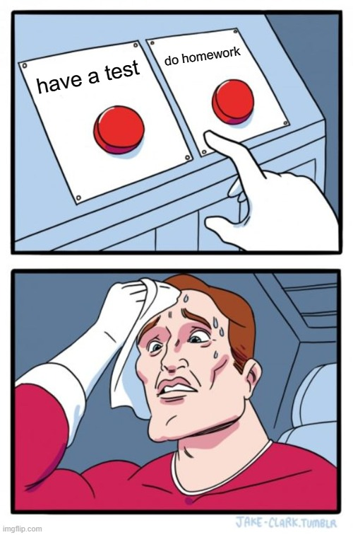
Tough Question Time: In Python can you tell if x, s and d are the same data type?
Different
Same

Slide 6

What about in C?
Different
Same

Slide 7
Typing for expressions
Languages like C are statically typed.
Statically typed programming languages do type checking at compile-time.
Languages like Python are dynamically typed.
Dynamically typed programming languages do type checking at run-time.
Why do we care?
Link: https://stackoverflow.com/questions/1517582/what-is-the-difference-between-statically-typed-and-dynamically-typed-languages

Slide 8
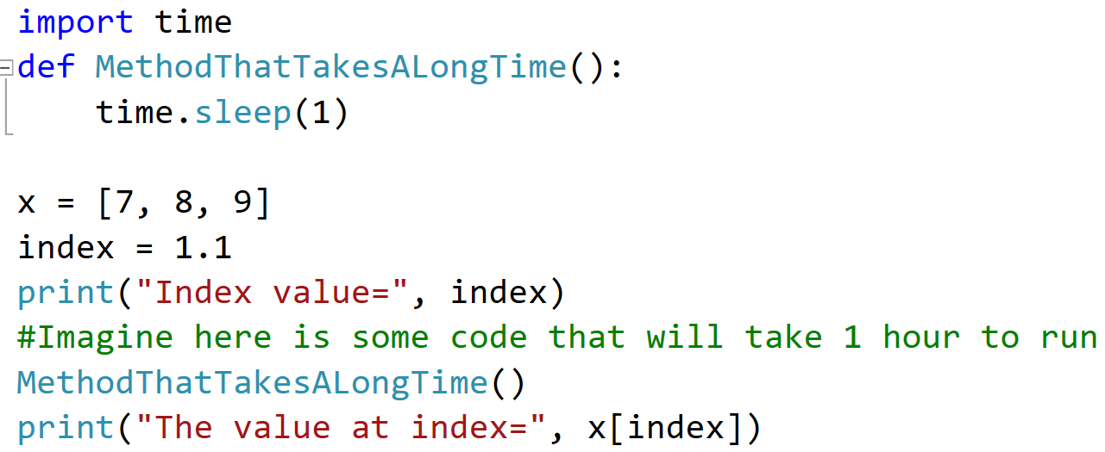
What is an advantage of a statically typed language?
We can illustrate the advantage with a buggy code…

Slide 9
What is an advantage of a statically typed language?

Slide 10
Where is the error in our code?

Slide 11
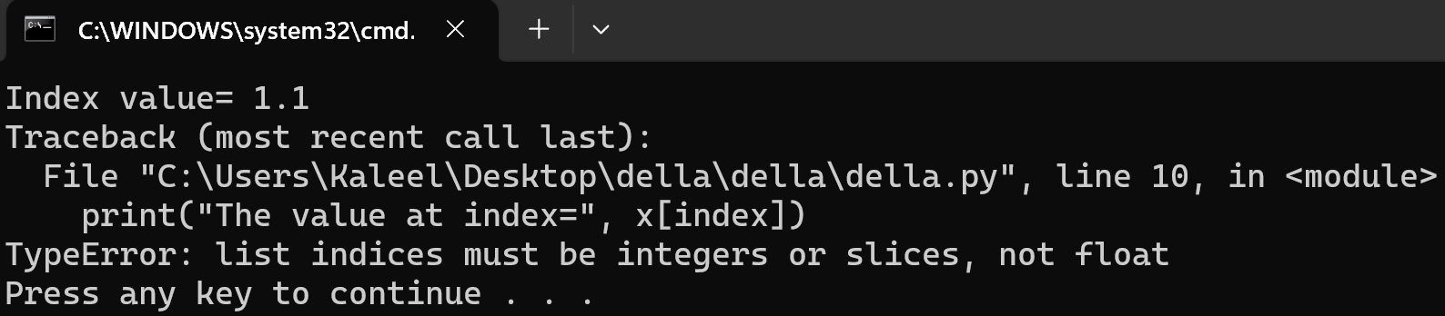
Where is the error in our code?
It will take us 1 hour to realize our code has an error in it!

Slide 12
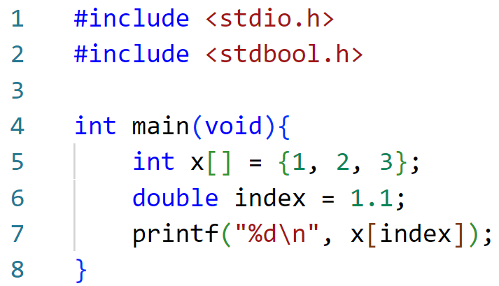
What would happen if we try the same code in C?

Slide 13
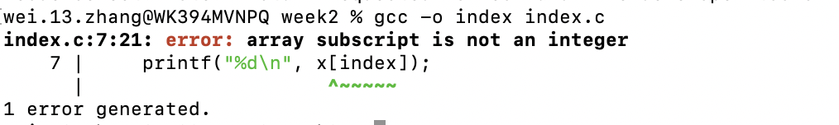
Trying to compile wrongly typed C code:
We can’t even compile…

Slide 14
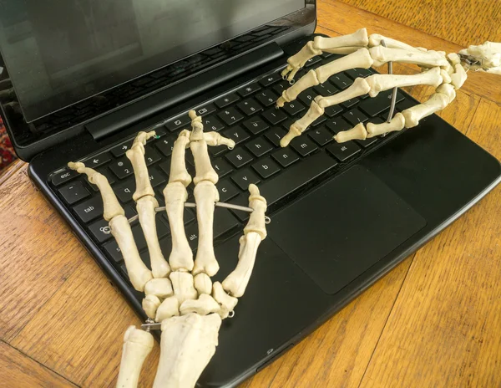
Statically Typed Languages
It can clearly be seen that a lot of error checking can be done by the compiler BEFORE the code ever runs for statically typed languages.
Are there any disadvantage to having a statically typed language?
Programmer hands after 1 day
of typing out data types for all expressions:

Slide 15
Lecture Overview
1. Static and Dynamic Typing
2. Expressions and Operators
3. Memory for Data Types and Characters

Slide 16
Expressions in C
All C expressions have a type
  Constants have a type
  Variables have a type
  Function return values have a type
  Every sub-expression of a larger expression has a type
Adding a semicolon to an expression makes it a statement.

Slide 17
A Few Basic Data Types in C
int
  An integer
char
  A single byte that can store a character in ASCII
  An 8-bit integer
float
  Floating point numbers
Quick refresher: What is a bit and what is a byte?
  A bit is simply a value 1 or 0.
  A byte is 8 bits.

Slide 18
Constants (of basic types)
// Constants cannot be changed
// char
'a', 'b', '\n'
// integer (note that compiler stores them in binary)
200, -34
0x7fffFFFF // hex
07112 // octal
// floating point numbers
3.1415, -0.34, 1.3E20

Slide 19
Variables
All variables must be declared and initialized before use
Variable declarations specify the type and name
  Compiler allocates memory based on type
  Valid names consist of letters (case sensitive!), digits, and '_', but cannot start with digits
  Multiple variables of the same type can be declared together
  Variables can be initialized when declared (“variable definition”) or using separate assignments
Examples: char c;
int i, j, k = 1;
float f;

Slide 20

Operators
Conventional arithmetic, bitwise, and logical operators
+ - * / %
& | ~ ^ << >>
&& || !
Pre/post increment/decrement (as in Java, C++, etc.)
  i++ ++i j-- --j
  c = i++; // c will be (i - 1)
  c = ++i; // c will be the same as i
Something seems off…

Slide 21
The ++ and -- Operators in Practice
int i = 4;
int c = i++;
int i = 4;
int c = ++i;
First set i to 4.
Second set c to same the value of i. So c will be 4.
Third add one to i. Now i will be 5.
First set i to 4.
Second increment i. So now i is 5.
Third set c to the same value of i. So now c will be 5.

Slide 22
Precedence and associativity
Precedence determines which operation is done first
  If operators have the same precedence, use associativity
  Use parentheses
i + j * 10 – k / 20
(i + (j * 10)) – (k / 20)
Most
Least

Slide 23
Assignment operators
Assignment operator
LHS = Expression
  LHS (Left Hand Side) is something that can be written to (e.g, a variable)
  LHS and Expression have “compatible” types
  The value of Expression is assigned to LHS and becomes the value of the assignment operation
Compound assignment operators (+=, *=, …)
var op= expr var = var op expr

Slide 24
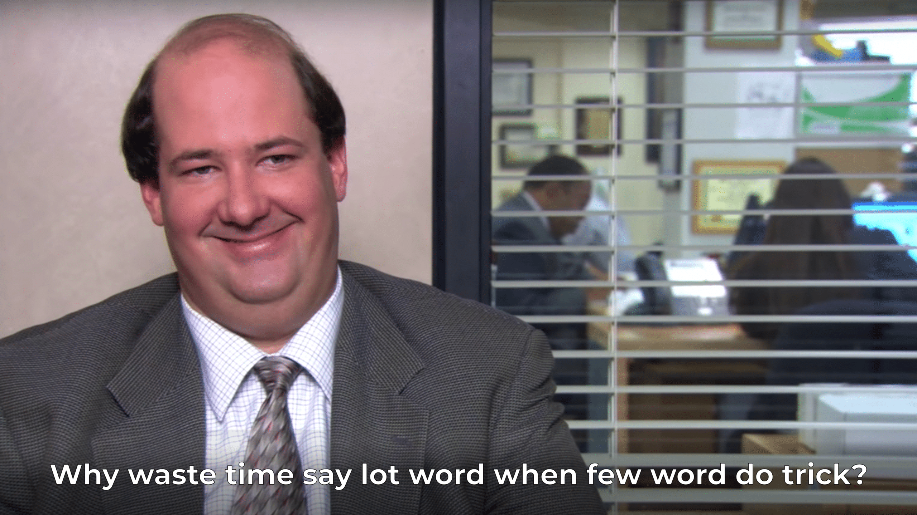
Compound Operators
Compound Operators
Examples:
a = x + y; b = c = d = 0;
i += 10; // i = i + 10
j *= 5; // j = j * 5

Slide 25
Assignments ARE NOT Statements
Assignments are expressions and “=” is an operator
  You can chain them!
  You can use them inside larger expressions
int a,b,c;
a = (b = (c = 10));
c = 10;
b = 10;
a = 10;
int a,b,c;
a = b = c = 10;

Slide 26
One more assignment example:
int a,b,c;
b = 2;
c = 3;
a = b + c;
int a,b,c;
a = (b = 2) + (c = 3);
Open question: would this be considered good practice?

Slide 27
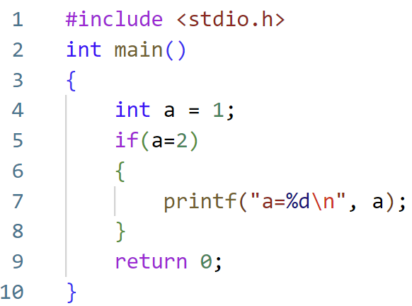
Coding Assignment Example
a=2

Slide 28
Lecture Overview
1. Static and Dynamic Typing
2. Expressions and Operators
3. Memory for Data Types and Characters

Slide 29
Integer Data Types
char
short int ⬅➔ short
int
long int ⬅➔ long
long long int ⬅➔ long long
And unsigned versions like “unsigned char”, “unsigned short”, etc.
How many bytes does each take?
  Depends on CPU architecture and compiler

Slide 30
Consider x86_64 (64-bit architecture)
size (in bits) | signed | unsigned
8 | char -128 .. 127 | unsigned char 0..255
16 | short -32768..32767 | unsigned short 0..65535
32 | int - 2³¹ .. 2³¹ - 1 | unsigned int 0..2³²-1
64 | long - 2⁶³ .. 2⁶³ - 1 | unsigned long 0..2⁶⁴ -1
64 | long long - 2⁶³ .. 2⁶³ - 1 | unsigned long long 0..2⁶⁴ -1

Slide 31
Consider i386 (32-bit architecture)
size (in bits) | signed | unsigned
8 | char -128 .. 127 | unsigned char 0..255
16 | short -32768..32767 | unsigned short 0..65535
32 | int - 2³¹ .. 2³¹ - 1 | unsigned int 0..2³²-1
32 | long - 2³¹ .. 2³¹ - 1 | unsigned long 0..2³²-1
64 | long long - 2⁶³ .. 2⁶³ - 1 | unsigned long long 0..2⁶⁴ -1

Slide 32
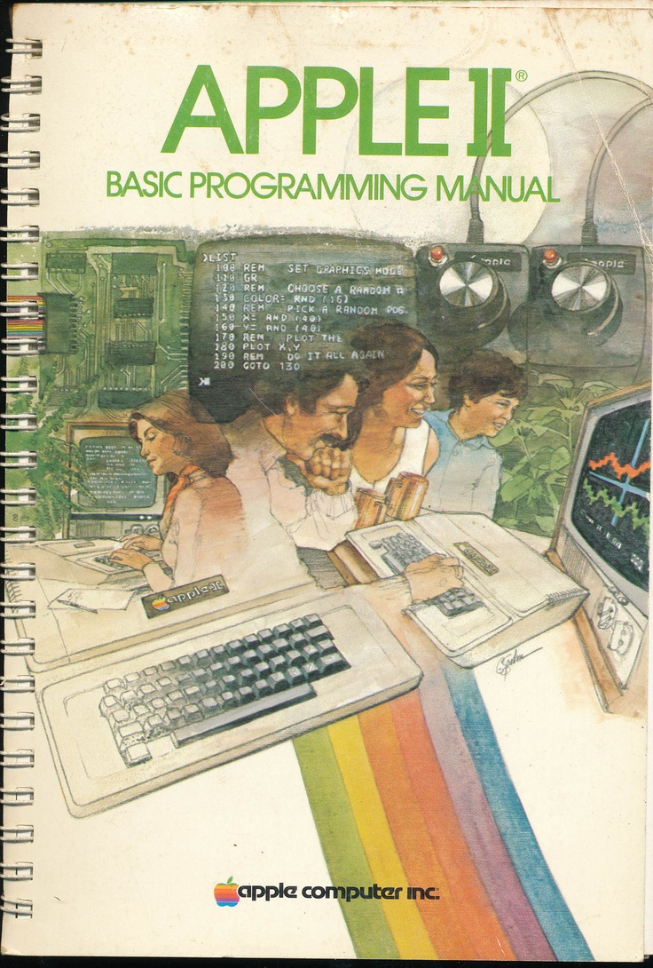
How to determine memory (space) requirements when running my program?
Answer: Read and memorize the hardware manual for every computer architecture design from 1980 onward.

Slide 33
How much space?
How to determine the amount of space for some type?
Operator sizeof gives the number of bytes needed for a type or a variable
  You will need this later to dynamically allocate space!
sizeof(T)
Examples:
int i;
sizeof(int); sizeof(i);
// 4 on the machines we use in this course

Slide 34
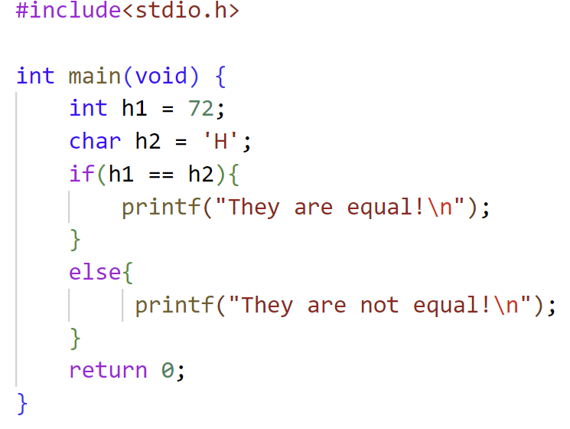


An Example Code to Check Equality
What will be printed?

Slide 35
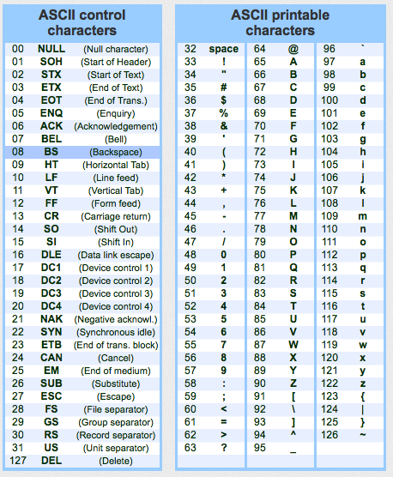
Character (char) Data Type
char has 8 bits (a byte)
ASCII code
  Characters are mapped to an integer in 0..127
  An ASCII character can be stored in char
Classes in ASCII
  0..31: “Control” character (aka, non-printable)
  48..57: Digits
  65..90: Upper case letters
  97..122: Lower case letters

Slide 36
So…
65..90: Upper case letters
The character ‘H’ is none other than …. 72
Observe how…
  ‘0’ through ‘9’ are consecutive!
  ‘A’ through ‘Z’ are consecutive!
  ‘a’ through ‘z’ are consecutive!
char ch = '8';
int x = ch – '0'; // What is the value of x?
Want to see ASCII table in your terminal?
man ascii

Slide 37
Non-printable characters
These are sometimes useful
  Showing the constant (literal)
'\n' | newline
'\r' | carriage-return
'\f' | form-feed
'\t' | tabulation
'\b' | backspace
'\x7' | audible bell (x indicates hexadecimal)
'\07' | audible bell (0 indicates octal)

Slide 38
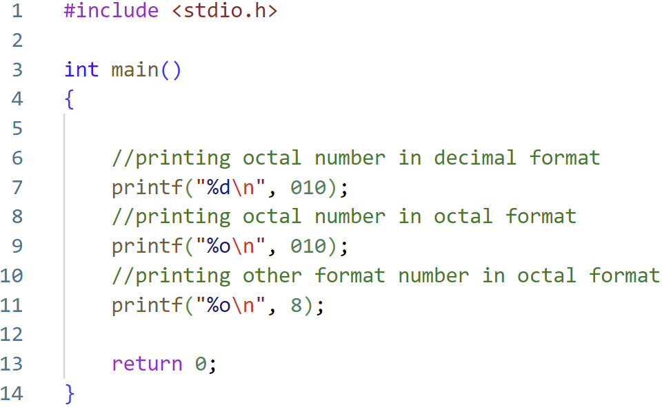
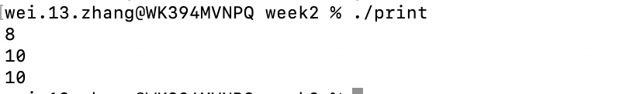
Printing Code Example

Slide 39
Automatic Type Conversion
When an operator has operands of different types, the operands are automatically converted to a common type by the compiler
  In general, a lower rank operand is converted into the type of the higher rank one, where
  char < short < int < long < long long < float < double < long double
  E.g., 1 gets converted to double before performing the addition in the expression 1 + 2.5
Automatic conversion can also occur across assignments
  The value of the expression on right hand side may be widened to the type of the LHS, e.g., double d = 1;
  Or narrowed (possibly with information loss), e.g., int i = 2.5;
Read the book for more details!

Slide 40
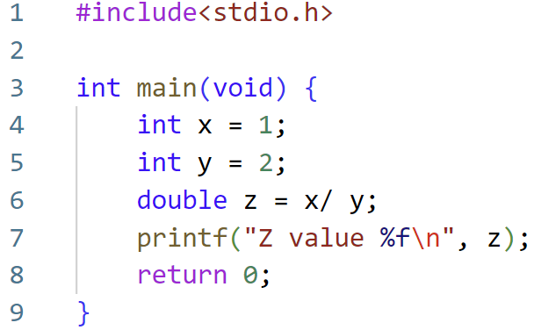
Type Conversion Example 1
0

Slide 41
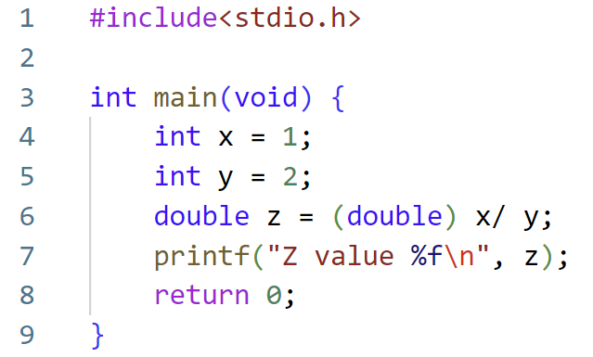
Type Conversion Example 2
0.5

Slide 42
Would this work?
z = (double)(x / y)

Slide 43
What About Booleans?
K&R and C89/C90 do not have a Boolean data type
  0 “means” FALSE and anything else “means” TRUE
  Common to use int or char to store Boolean values and define convenience macros
C99 introduced _Bool
  A variable of _Bool type is either 0 or 1
#define BOOL char
#define TRUE 1
#define FALSE 0

Slide 44
Integers of specific sizes (C99)
#include <stdint.h>
int8_t // signed 8 bits integers
int16_t
int32_t
int64_t
uint8_t // unsigned 8 bits integers
uint16_t
uint32_t
uint64_t
// Many projects have their own *standard* types

Slide 45
Strings
String is not a basic type
A string is an array of characters
  Will be discussed more later
"Hello world!\n"
"Hello " "world!\n" // Useful for long strings
"It's \"Mickey\"\n" // Escape double quotations
"A bell \007\n" // Can use ASCII code

Slide 46
Be careful mixing types
Sometimes the results may not be as expected!
  What is the size (in bits) of each operand?
  Are your operands signed or unsigned ?
_Bool b1;
char b2, b3;
int i = 256; // 0x100
b1 = i;
b2 = i;
b3 = i != 0;
b1 is 1 because i is not 0
b2 is 0 because lowest 8 bits in i are 0
b3 is 1 because i is not 0
Do you want b2 or b3?

Slide 47
Figure Sources
https://i.imgflip.com/5wgm69.jpg
https://upload.wikimedia.org/wikipedia/commons/thumb/e/e0/SNice.svg/800px-SNice.svg.png
https://i.imgflip.com/1rflc0.jpg
https://st.depositphotos.com/1726977/1219/i/450/depositphotos_12193152-stock-photo-boney-skeleton-hands-working-a.jpg
https://sonder.com.au/wp-content/uploads/2020/10/quality-over-quantity-blog@2x.png
https://i.pinimg.com/736x/8b/f2/2a/8bf22a209224c73dd1618d6c12f2474d--basic-programming-apple-ii.jpg
https://humornama.com/wp-content/uploads/2020/12/You-Are-A-Good-Question-meme-template-of-Tanu-Weds-Manu-Returns-1024x576.jpg

